Slide 1

Hotel Management System
Yuchen Wei
Xinfu Guo Data Structure project

Slide 2
Factory Pattern
Decorator Pattern

Slide 3
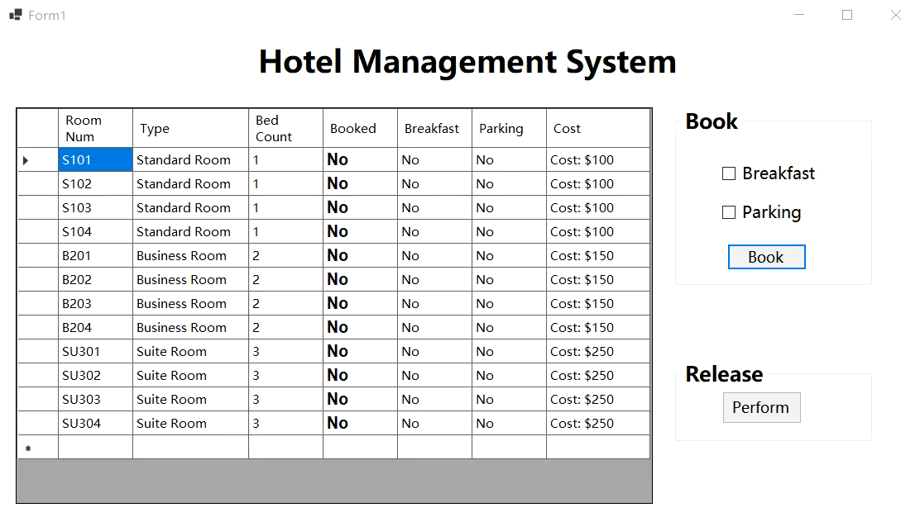

Slide 4
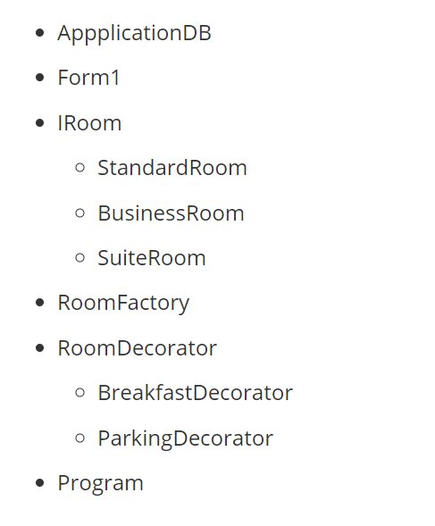
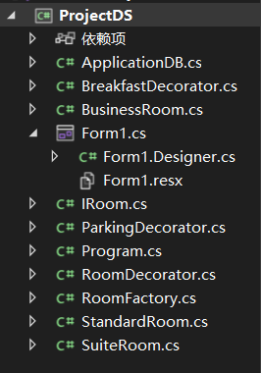

Slide 5
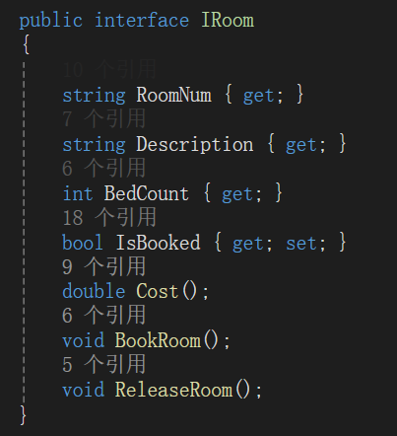
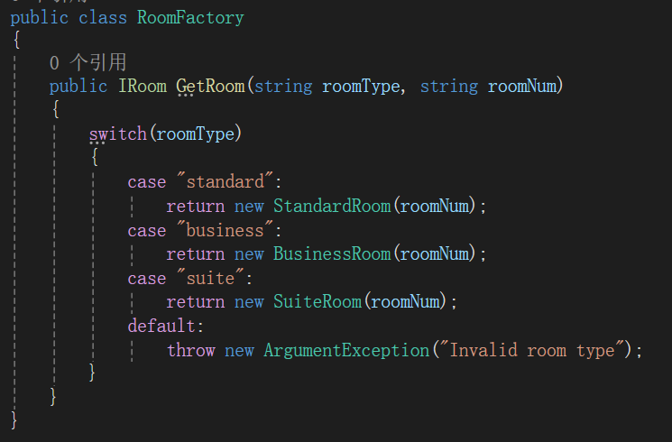
Factory Pattern

Slide 6
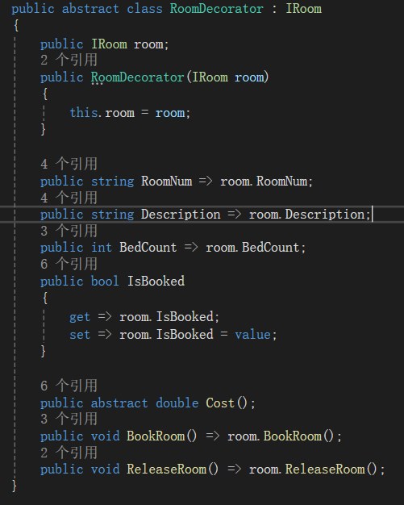
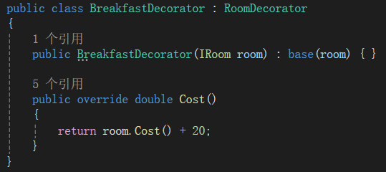
Decorator Pattern

Slide 7
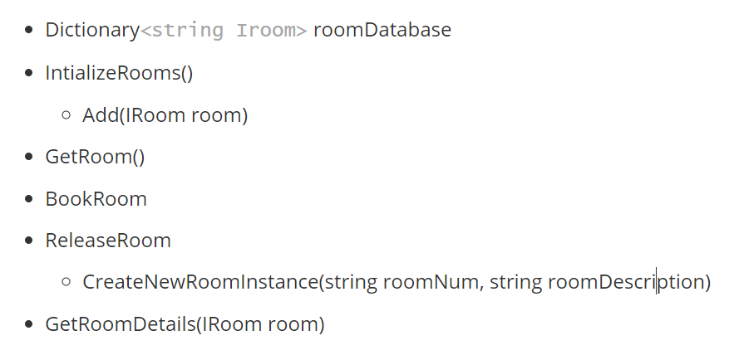
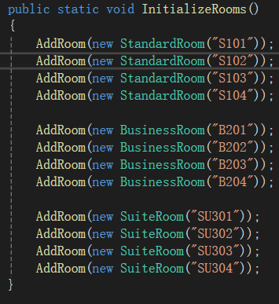
ApplicationDB

Slide 8
Any Questions?

Slide 9

Thank you

